Slide 1
Software Development Project-II CSE 3200
Real Time Moving Object Tracking System.

Slide 2
PROJECT SUPERVISOR: Prof. DR. MMA Hashem DEPT. OF CSE, KUET
DEVELOPED BY
Abdul Aziz Md. Masum Al Masba
Roll: 1207001 Roll: 1207012

Slide 3
LAYOUTS
Introduction
Motivation
Objectives
Working procedure and Flow Diagram
Window’s View
Limitations
Future plan
Conclusion

Slide 4
Introduction
Java is a general purposes object-oriented programming language useful for developing machine independent software.
In this modern world most of the Android application are developed by Java language.
To develop our project we preferred Android Studio version 1.3 in windows 10 platform.
This is our 2nd project and we have tried our best to make this user friendly and bug free.

Slide 5
Motivation
During the time of waiting for bus/train in station, the passengers need to know the current location of the bus/train as well as how far the bus/train from the station.
Sometimes we don’t find our child and We need to locate the children’s current location so that they may not go far away from the house.
We need to track the location of criminals by inserting the GPS module into their body.

Slide 6
Objectives
To track a real time moving object such as vehicle, children etc. in which place they are and they were.
To find the shortest road and distance between the Tracker and Tacking Object.
To track how to go to the object’s place with a 3D animation view in the map.
To see the street view of the current position of the object.
Finally we try to make the people fast and satisfied is the main objective of our project.

Slide 7
Working procedure of Moving Object Tracking System.
We divided our project into two main unit:
1. Tracked Application named Device Handler and
2. Client level Tracker Application named Real Time Moving Object Tracker.

Slide 8
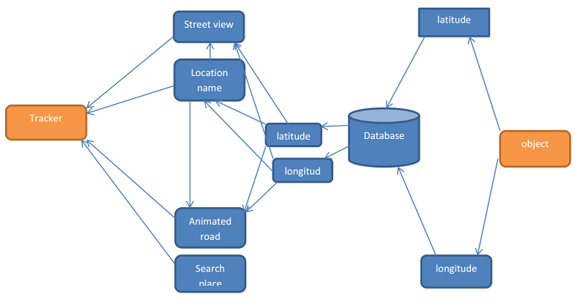
Flow of Control
Fig: Flow Diagram.

Slide 9
In this part the Device Handler will first logged in by user taking data from server. Then the handler have an option to update it’s location and time to the server.
On the other hand the Client level Tracker application can fetch those information and then track it.
With these information the Tracker can find out the road, distance between them, can see the animation view of the road.
There is also a option to see Street view of the current location of the object.

Slide 10
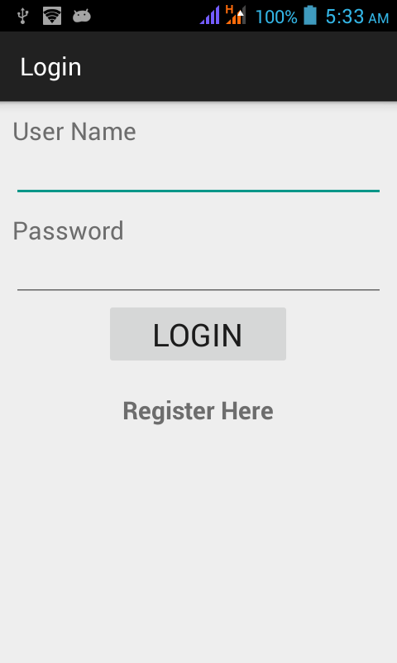
Device Handler Login window

Slide 11
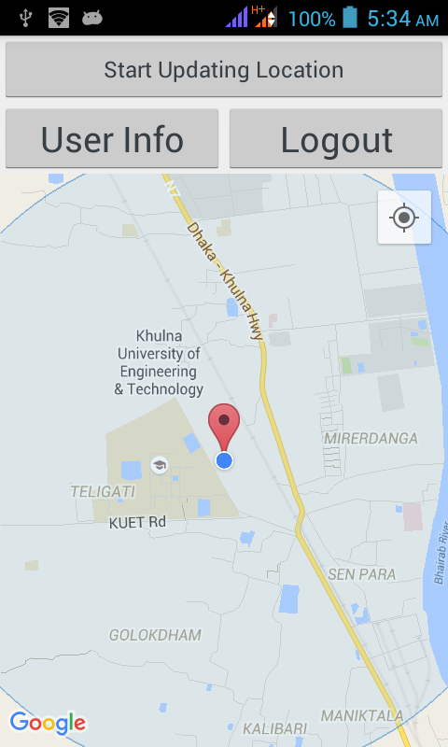
Device Handler Main Activity

Slide 12
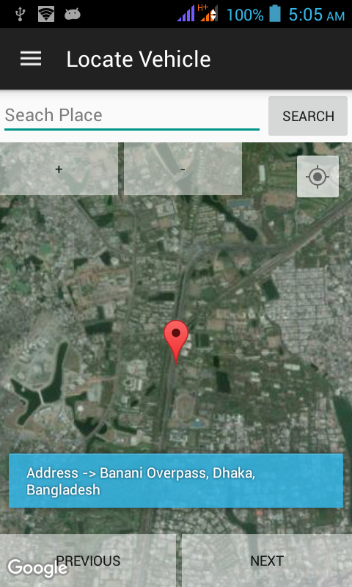
Locate The Last position of the Object

Slide 13
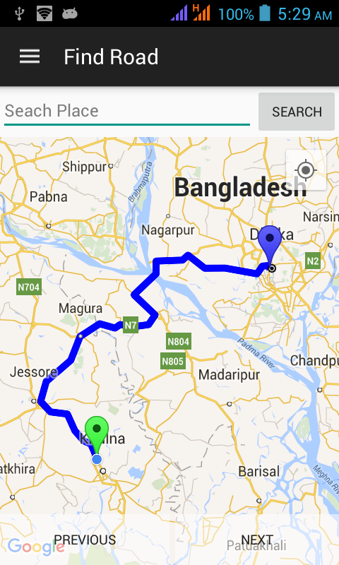
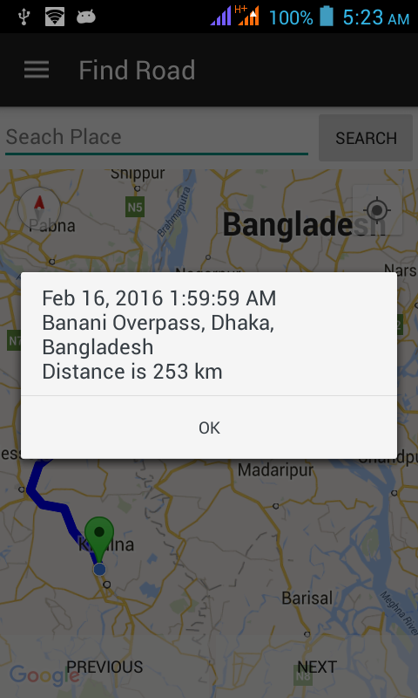
Finding pathway to go to the object and distance from the object

Slide 14
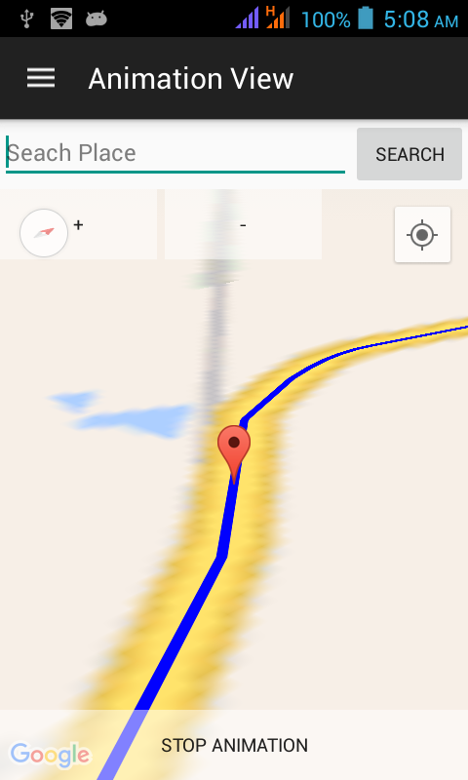
3D Animation view of road from user’s location to the Object

Slide 15
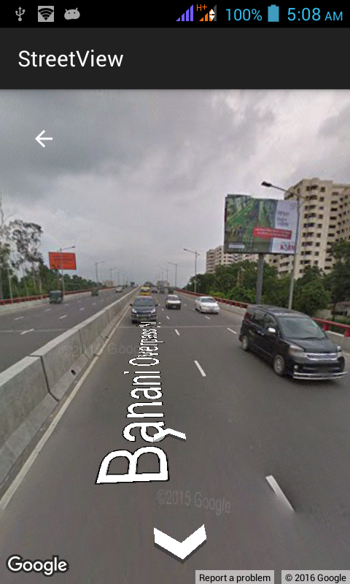
Street view of the current position of the object

Slide 16
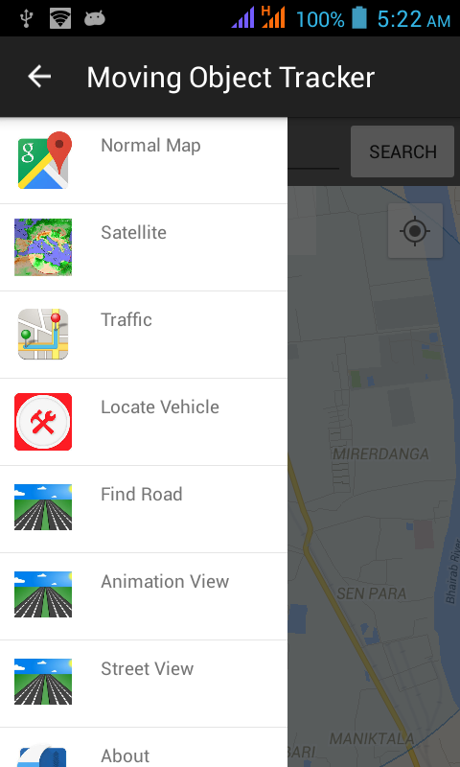
Sliding Menu

Slide 17
Limitation
The application is used to track only one moving object.

Slide 18
Future plan
The app should work for multiple objects.
There should be an alarm system when we reach the current position of the object.
There should go a message in a remote phone, when we reach at the current position of the object.

Slide 19
Conclusion
We have tried our best to make our project “Real Time Moving Object Tracker” a very simple and user friendly.
We demonstrated our program very simply by modulating java classes.
We profoundly thank our Supervisor sir for his helpings towards our project.

Slide 20
References
Google API.
Wikipedia.
Android Documentation.
com.github.jd-alexander:library:1.0.7

Slide 21
Thanks All

